Slide 1

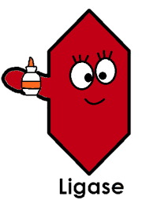
∆crp
...gcaatgagacaagaacgaaaagcgtttacctcggaactctattgta-3’
...cgttactctgttcttgcttttcgcaaatggagccttgagataacat-5’
5’-gaaaagcgtttacctcggaactctattgtagaacccctat...
3’-cttttcgcaaatggagccttgagataacatcttggggata...
AmpR
5´ to 3´ exonuclease
...gcaatgagacaagaacgaaaagcgtttacctcggaactctattgta
...cgttactctgttcttg
gaacccctat...
cttttcgcaaatggagccttgagataacatcttggggata...
DNA ligase
...gcaatgagacaagaacgaaaagcgtttacctcggaactctattgta
...cgttactctgttcttg||||||||||||||||||||||||||||||gaacccctat...
cttttcgcaaatggagccttgagataacatcttggggata...
∆crp
...gcaatgagacaagaacgaaaagcgtttacctcggaactctattgtagaacccctat...
...cgttactctgttcttgcttttcgcaaatggagccttgagataacatcttggggata...
AmpR

